Slide 1

Since the dawn of time
Notes:
ALI
Humans have been fascinated by the idea of finding patterns in human behavior to predict the most likely or desirable outcomes. This helps ensure that valuable resources are not utilized inefficiently or wasted, as they are finite.

Slide 2
How can we judge ?
MAHESH
1
ANTHONEY
0
Notes:
ALI
Which teaching assistant (TA) is better than another? For instance, how do we determine if Mahesh should receive a score of 1 and Anthony a score of 0? What metric or method are we using to assign these scores?
Ladies and gentlemen, the 1s and 0s are the most critical aspects of our database. These numbers form the foundation upon which we compute and determine the outcomes of our machine learning program.

Slide 3
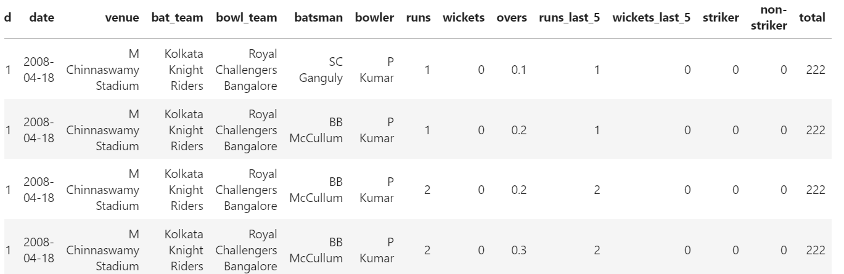
How can we judge ?
IPL_HISTORY.CSV
Notes:
ALI
Which teaching assistant (TA) is better than another? For instance, how do we determine if Mahesh should receive a score of 1 and Anthony a score of 0? What metric or method are we using to assign these scores?
Ladies and gentlemen, the 1s and 0s are the most critical aspects of our database. These numbers form the foundation upon which we compute and determine the outcomes of our machine learning program.

Slide 4
WIN WIZARD
Project 4
Kashish Jain
Ali Khan
Abid Hussain
Amir Siddiqui
Notes:
ALI

Slide 5

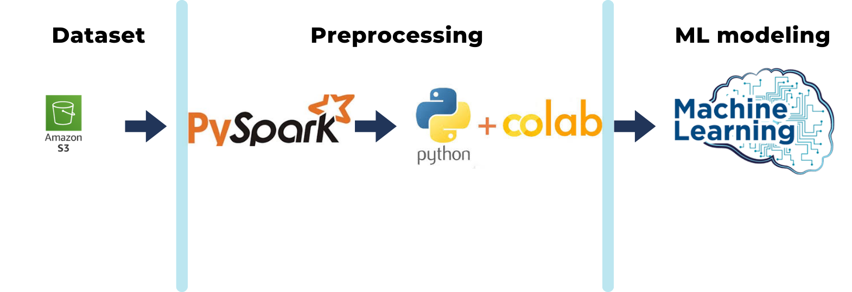
Notes:
AMIR
MY JOB FOR TO FUNNEL OUT THE TECHNOLOGIES WHICH WILL BE USED TO TRAIN OUR MODEL

Slide 6
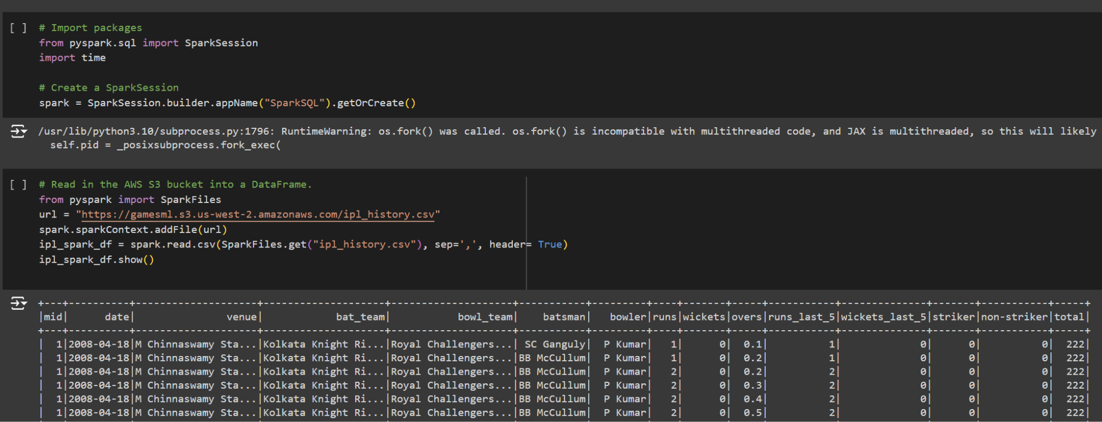
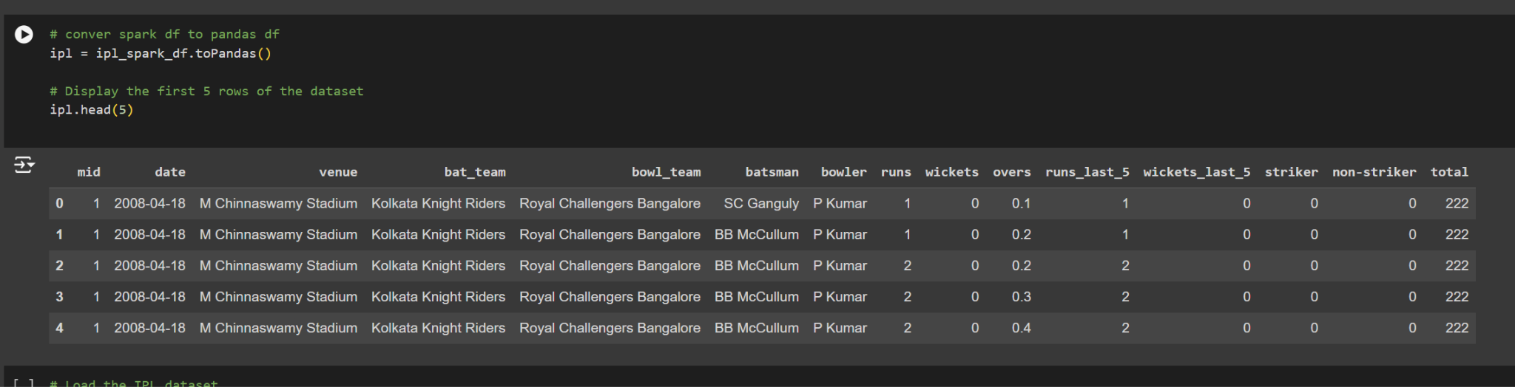
Initiated a Spark session to process our dataset;
Read an IPL history CSV file from AWS S3 bucket into Spark Dataframe;
Which was converted into a Pandas Dataframe for easier manipulation.
Notes:
AMIR
MY JOB FOR TO FUNNEL OUT THE TECHNOLOGIES WHICH WILL BE USED TO TRAIN OUR MODEL

Slide 7
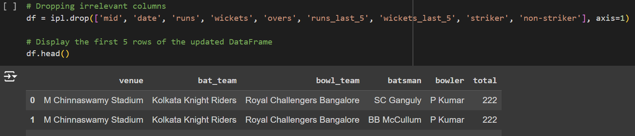
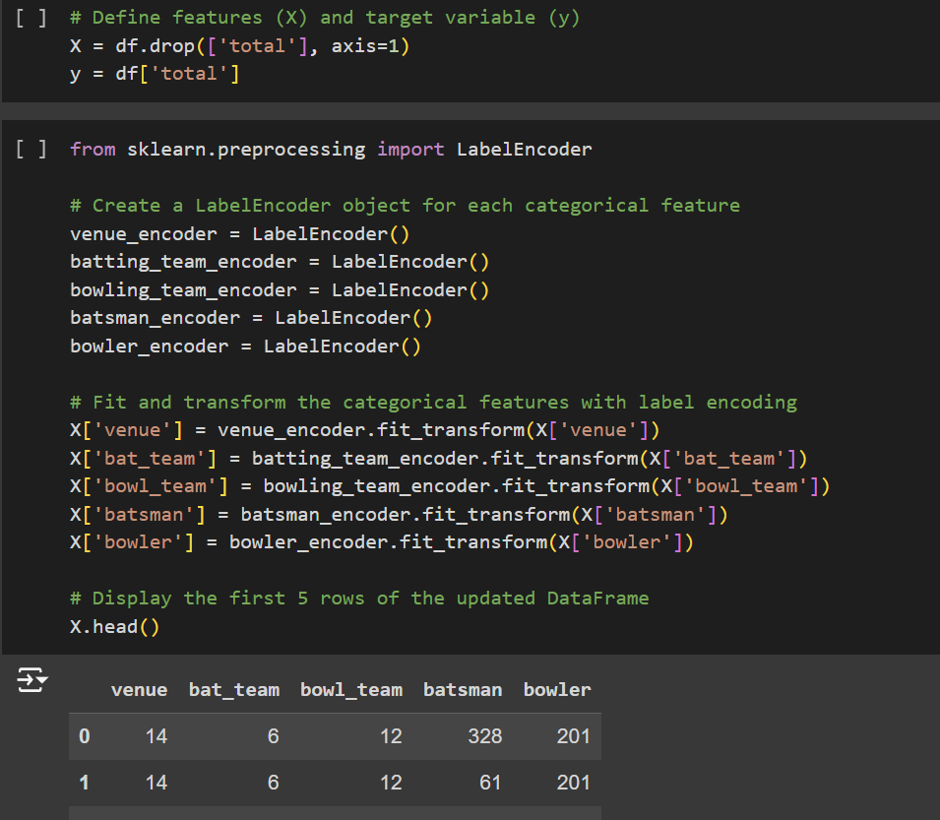
Dropped irrelevant columns to simplify our dataset;
Categorical features were encoded using LabelEncoder.
Data was split into training and testing sets, using 70% for training and 30% for testing;
MinMaxScaler was utilized for scaling the features
Notes:
AMIR
MY JOB FOR TO FUNNEL OUT THE TECHNOLOGIES WHICH WILL BE USED TO TRAIN OUR MODEL

Slide 8

ML models used for predicting Runs:
Dataset - S3 Bucket
Preprocessing
Linear Regression
Random Forest
Neural Networks
Evaluation Metric
Evaluation Metric
Evaluation Metric
Notes:
ABID
Thanks Amir, the tree shows the architecture for different machine learning models used for predicting the runs the team is going to score. The evaluation metric is used for comparing the predictions from each model.

Slide 9
Linear Regression:
Simplest model for predicting
Linear in nature : y=mX +C
LinearRegression from scikit Learn
Random Forest:
Captures Non Linearity between features and target
Less affected by outliers
Provides feature importance
Neural Network:
Captures complex Non Linearity between target and features
Hard to determine how they arrived at the predictions.
Metric comparison:
Metrics | Linear Regression | Random Forest | Neural Network
Mean Absolute Error | 22.68 | 1.58 | 16.4
R2 score | 0.0 | 0.9 | 0.34
Notes:
ABID
Three different models have been used for predicting the runs based on the features. Linear regression is the simplest model. It incorporates a linear relationship between target and features. At the same time random forest handles non linearity between the features and targets. It also provides a feature importance scores which helps in understanding relevance of each feature. We have used Neural network model to predict runs that can be scored by the team. The table summarises the comparison between metrics for different models. R2 scores predict how well the models prediction matches with actual data. 1 means perfect prediction and ) indicates model is no better than the mean of targeted values.

Slide 10
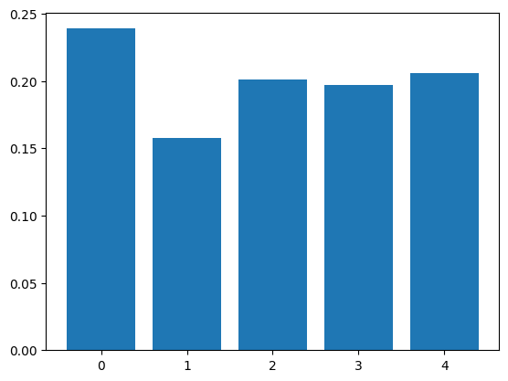
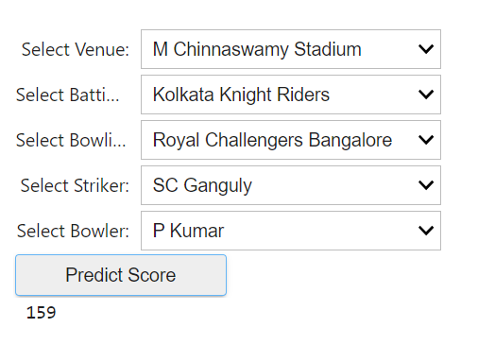
Feature importance - Random Forest
Score prediction using deep learning
Future scope of work:
Incorporating player attributes as per their performance till date.
Adding more features, ex: previous players and their performance.
Building team as per the match.
Notes:
ABID
A snapshot of the feature importance on the left and our prediction tool on the right. To make this prediction tool more accurate and reliable alot more can be done. Adding player attributes, their performance, building team, individual player scores in previous matches.
Kashish will provide demonstration of the tool. Go ahead kashish.

Slide 11
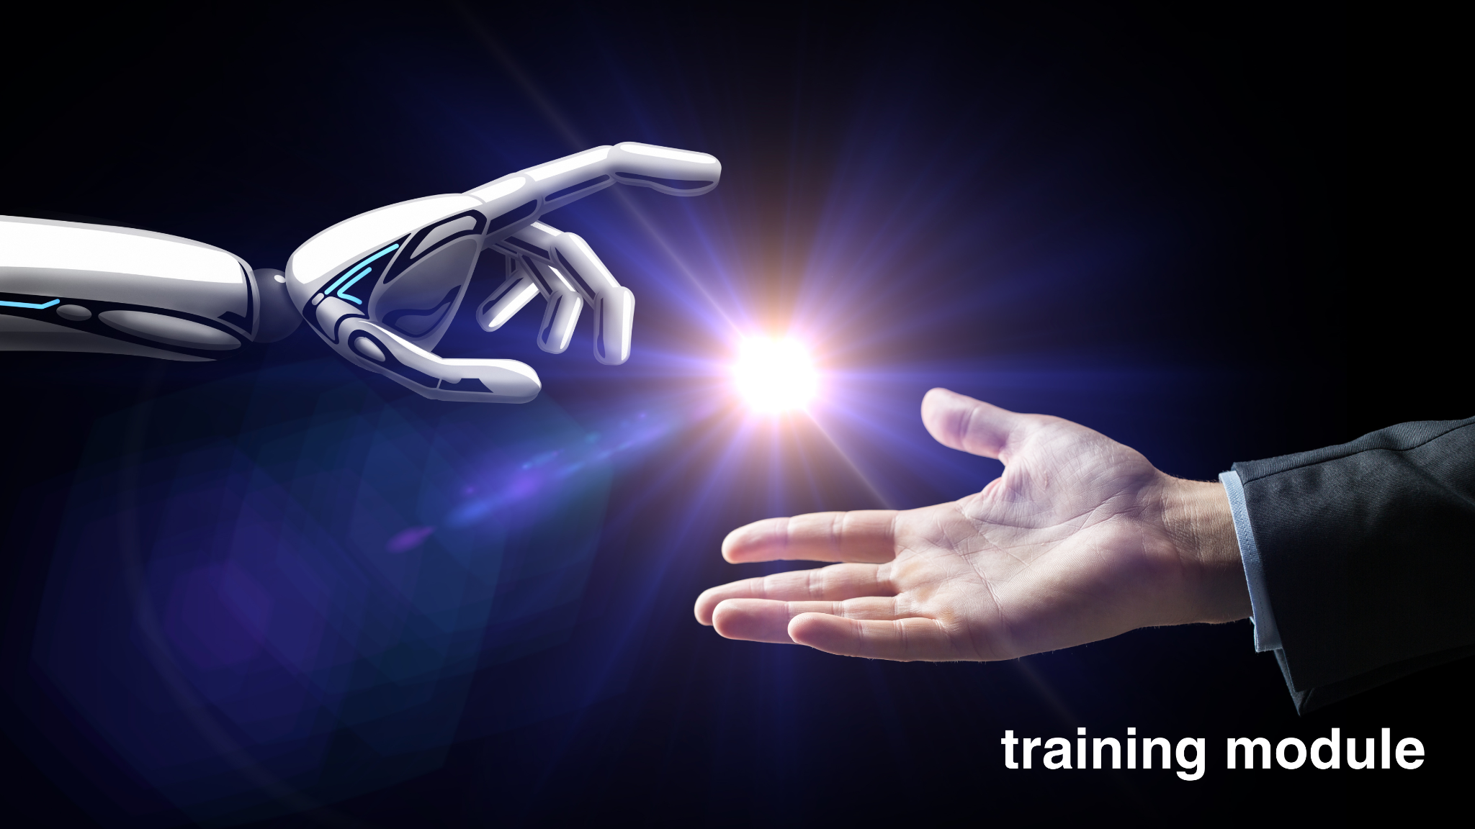
dEMO
Notes:
KASHISH

Slide 12

Notes:
KASHISH

